Slide 1
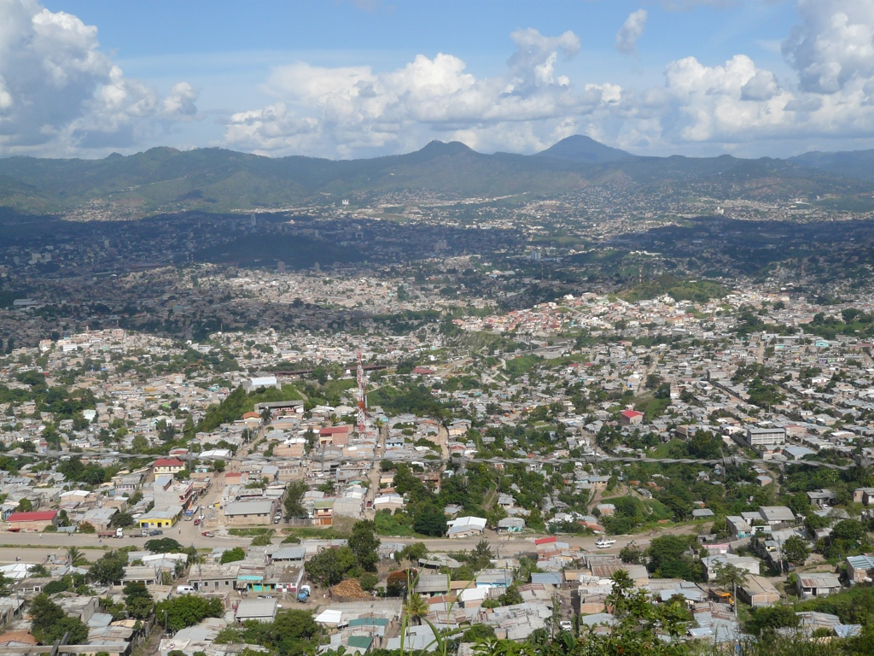
Adventures on the Honduran Horizon
2010 missionary report

Slide 2
THANK YOU
I thank God every time I remember you

Slide 3
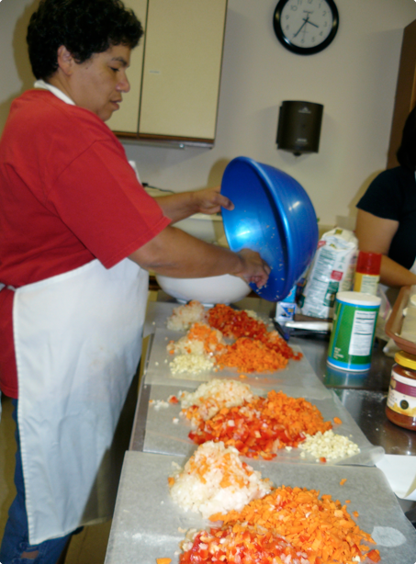
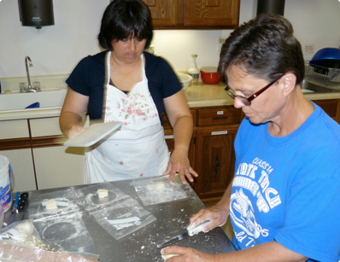
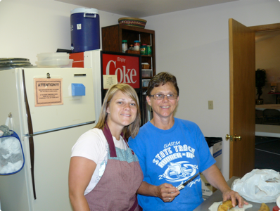

Slide 4
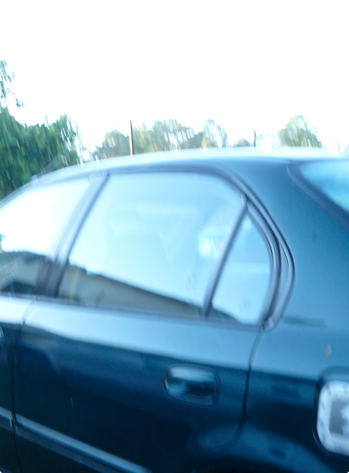
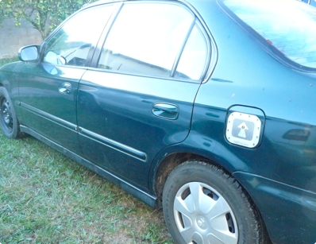
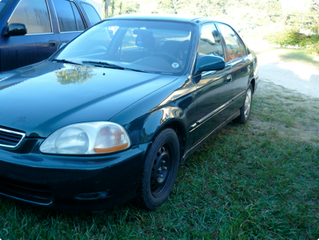

Slide 5

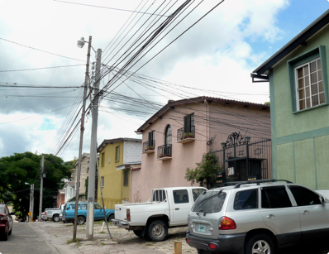
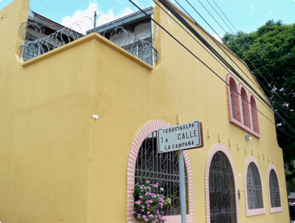

Slide 6
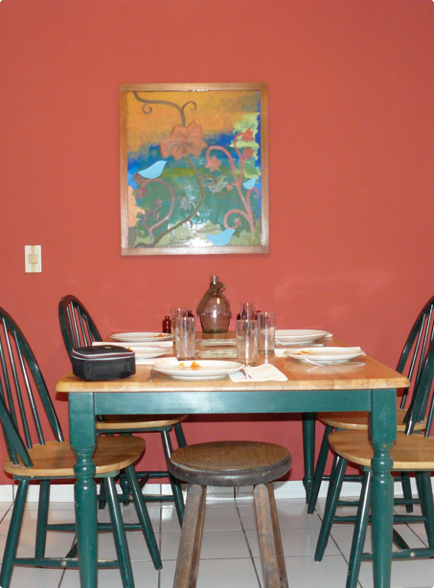
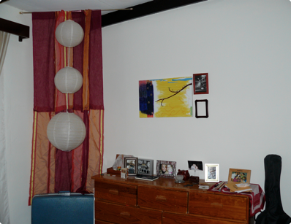
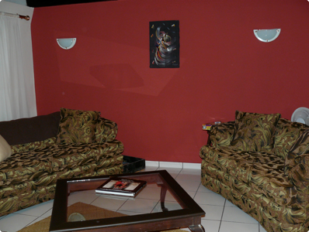

Slide 7
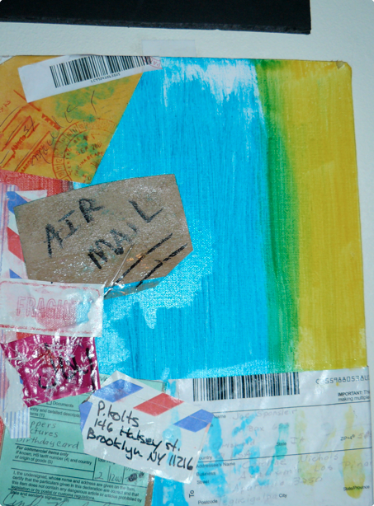
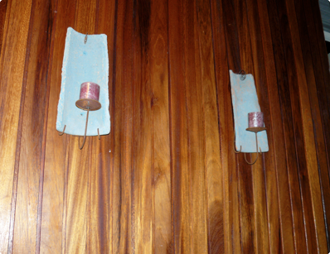
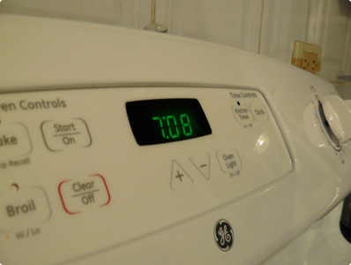

Slide 8
year two begins

Slide 9
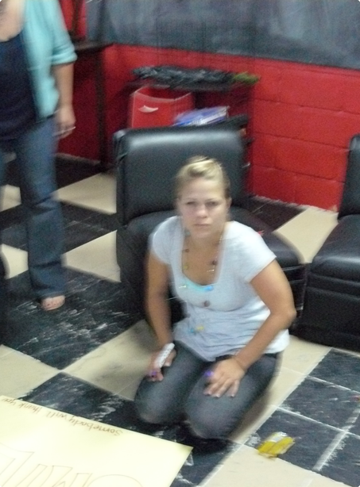
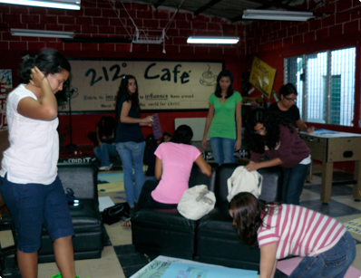
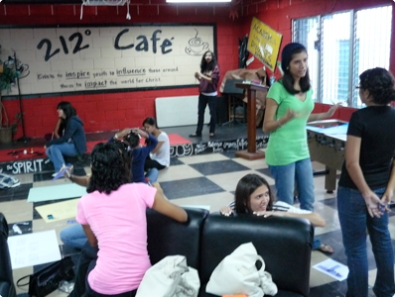

Slide 10
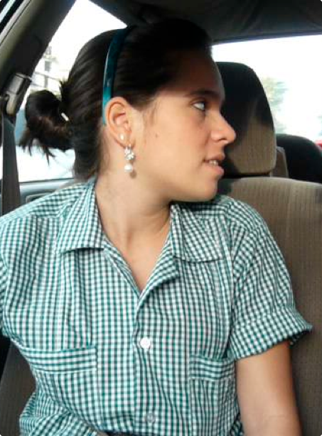
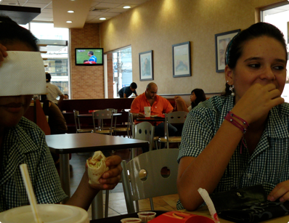
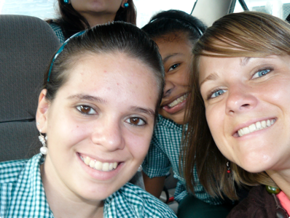

Slide 11
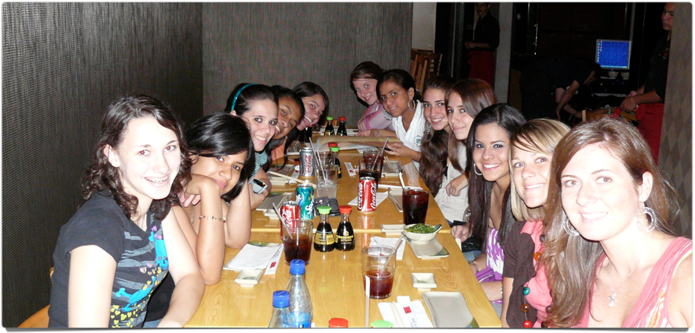

Slide 12
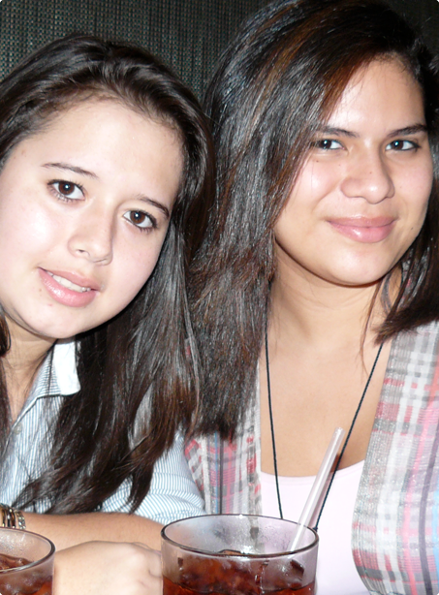
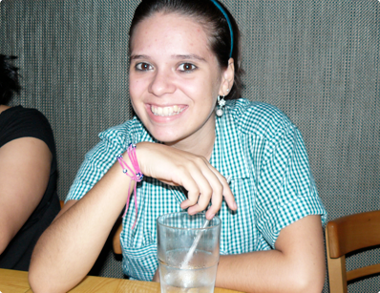
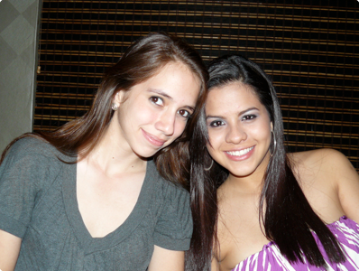

Slide 13
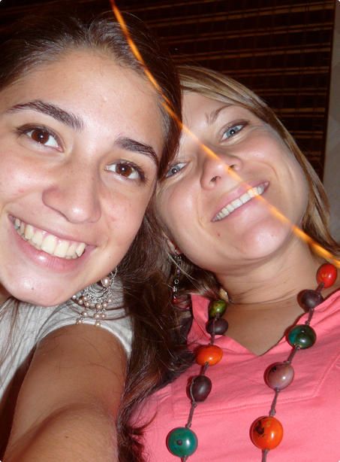
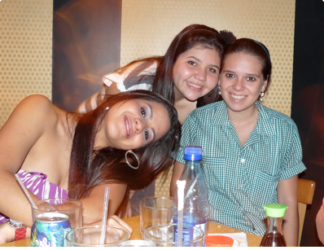
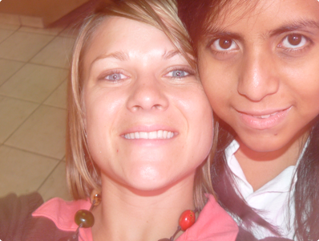

Slide 14
challenges
student relationships/discipleship
interruptions/crises
balance ministry/outreach involvement
unity among staff/high turnover
personal battles/trusting in God’s sovereignty

Slide 15
student relationships
For this reason I bow my knees before the Father, from whom every family in heaven and on earth is named, that according to the riches of his glory he may grant you to be strengthened with power through his Spirit in your inner being, so that Christ may dwell in your hearts through faith--that you, being rooted and grounded in love, may have strength to comprehend with all the saints what is the breadth and length and height and depth, and to know the love of Christ that surpasses knowledge, that you may be filled with all the fullness of God.
Ephesians 3:14-19

Slide 16
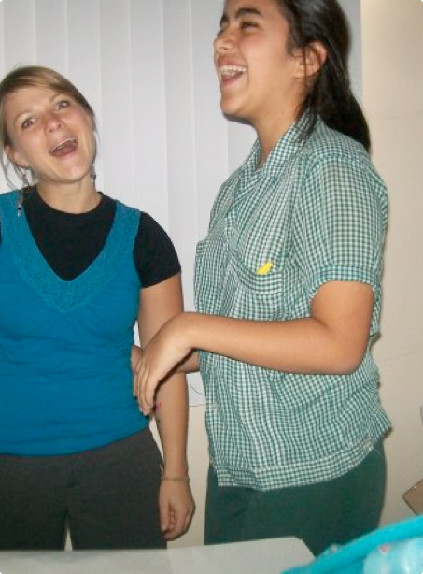
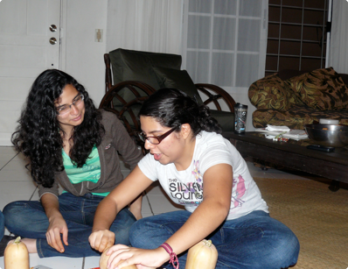
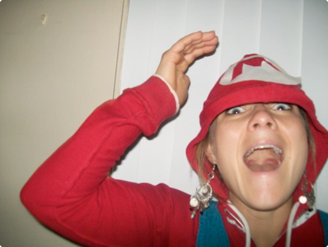

Slide 17
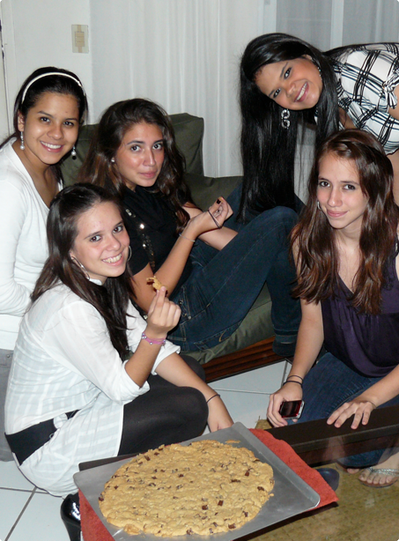
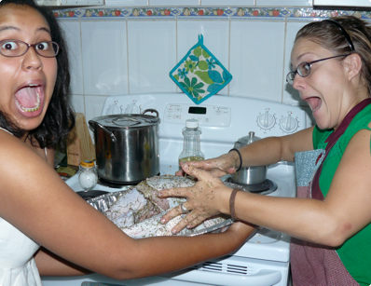
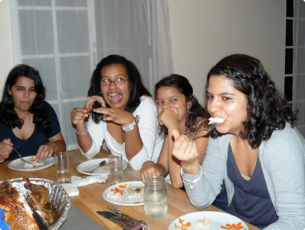

Slide 18
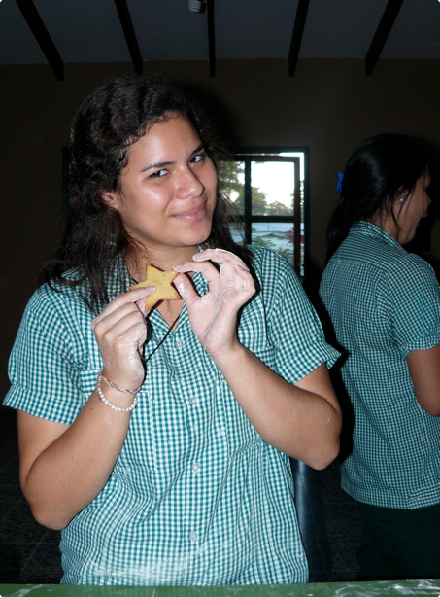
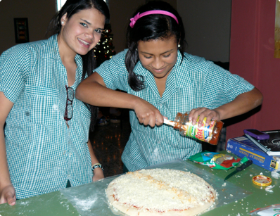
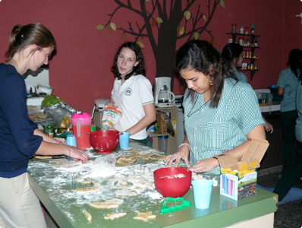

Slide 19
*plain words*
(*side note: still wish I could be face to face with you. lol)
last night as I prayed (and expressed myself on my journal with drawings.) I was finally able to SAY and CONFESS to GOD everything I'd done/been doing.
You've taught me so much. Most of my decisions and growth have been because of your wise words of comfort. but as I prayed last night and thought of you I realize I do need that at times, but I don't want to have you like this all my life. I want to put God first. I have realized that without Him I am NOTHING, and He ought be first in my life. Now, I have also realized it is about being convicted not moved by someones words. I have learned so much at my young age and so much of my past hurts, but I have to let go. I had never really realized how MUCH i have to LET GO OF THE PAST and built my present and future. Never will I forget what you have done, nor will I ever forget who you are, but I now know it is time for me to have you more as a friend who I know I CAN go to but don't HAVE to, then someone I just go to because I am need of LOVE. (*another side note: I wasn't being a hypocrite...i just didn't know.) I have to let go of every single person/thing that has been like that in my life.
You know, I stopped writing walls, inboxes, and emails because I felt uncomfortable. I always thought, "I'm bothering too much." but it is as if everything changes now. It's just that I feel I did a lot of stuff for my own comfort and to have a guarantee that you love me.
but anyways, this is getting too long. just wanted to share everything that came out of my mouth last night in prayer about what you have been trying to teach me in the past few months. in confession. and it was pretty awesome being able to truly breath, especially when I prayed for any bad spirits to be out of my room and that i needed God's own presence in my room. It was as if they were tying me up or something. ;)
love much,

Slide 20
interruptions/crises
You are a hiding place for me; you preserve me from trouble; you surround me with shouts of deliverance.
Many are the sorrows of the wicked, but steadfast love surrounds the one who trusts the Lord. Be glad in the Lord, and rejoice, O righteous, and shout for joy, all you upright in heart!
Psalms 32:7, 10,11

Slide 21
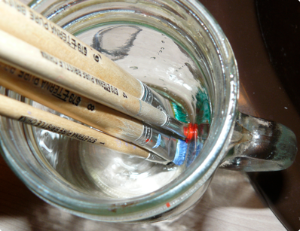
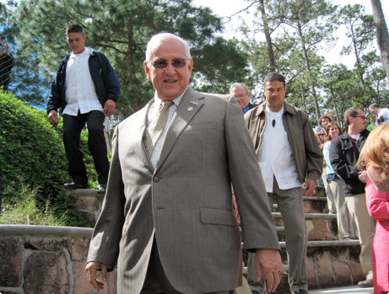
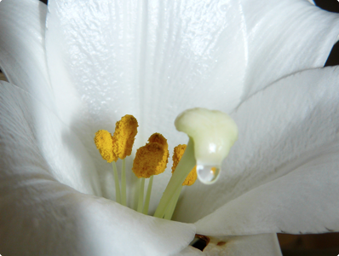

Slide 22
balance ministry/outreach
Whatever you do, work heartily, as for the Lord and not for men, knowing that from the Lord you will receive the inheritance as your reward. You are serving the Lord Christ.
Colossians 3:23

Slide 23
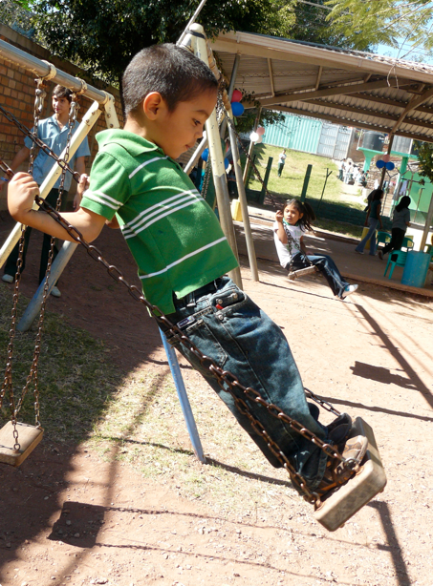
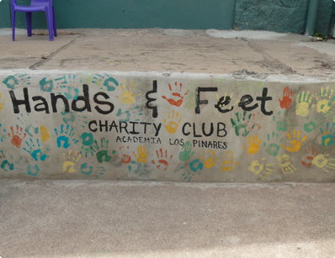
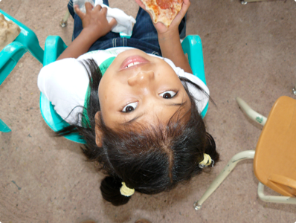

Slide 24
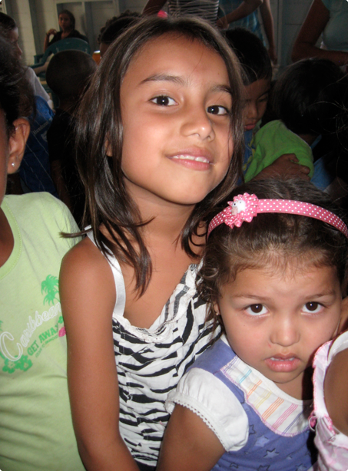
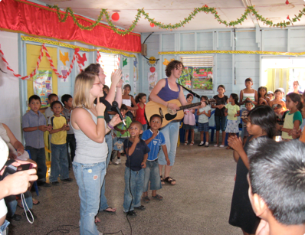
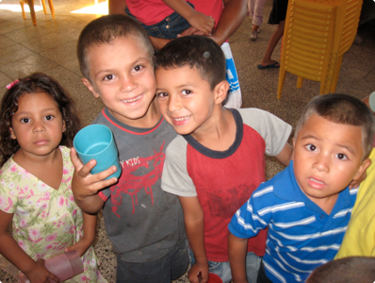

Slide 25
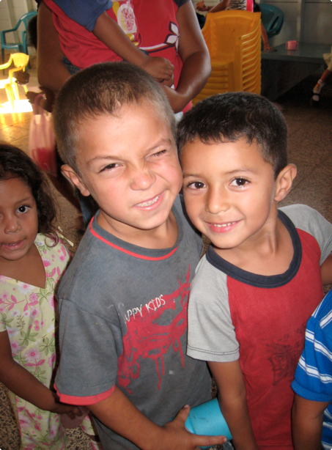
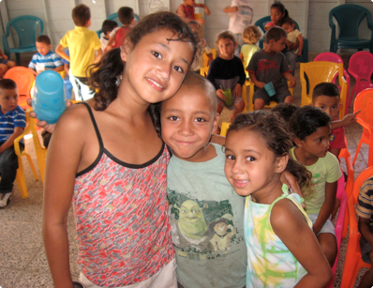
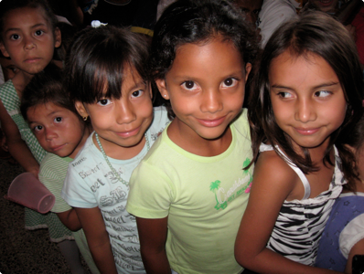

Slide 26
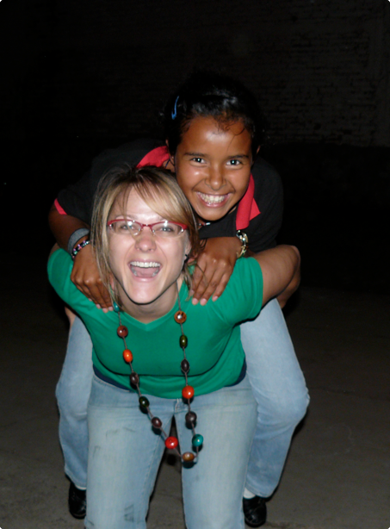



Slide 27




Slide 28




Slide 29




Slide 30


Slide 31




Slide 32




Slide 33




Slide 34




Slide 35




Slide 36
unity among staff/turnover
be like-minded, encouraging one another

Slide 37




Slide 38




Slide 39



Slide 40
personal battles/
God’s sovereignty
Ecclesiastes 5:20
John 10:10

Slide 41




Slide 42


Slide 43


Slide 44


Slide 45




Slide 46




Slide 47




Slide 48




Slide 49





Slide 50


Slide 51


Slide 53
“For this reason, since the day we heard about you, we have not stopped praying for you and asking God to fill you with the knowledge of his will through all spiritual wisdom and understanding. And we pray this in order that you may live a life worthy of the Lord and may please him in every way: bearing fruit in every good work, growing in the knowledge of God, being strengthened with all power according to his glorious might...

Slide 54
SO THAT you may have great endurance and patience, and joyfully giving thanks to the Father, who has qualified you to share in the inheritance of the saints in the kingdom of light. For he has rescued us from the dominion of darkness and brought us into the kingdom of the Son he loves, in whom we have redemption, the forgiveness of sins.” Colossians 1:9-14

Slide 55
Lessons learned:
God is faithful and His leadership is ultimate
I must love these kids out of my love for the Lord and not in hopes that they will love me back
Sacrifices are small prices to pay to preach/teach/love
Community is absolutely crucial to spiritual health
Fear, worry, anxiety, and distrust are not from the Lord

